Slide 1
Group 16
Checker Wars
Sam Alammar, Luke Austin, Alex Choi, Andrew Macatangay
Notes:
SCRIPT (ANDREW):
Hi! I hope everyone’s having a great morning! We are Sam Alammar, Luke Austin, Alex Choi, and Andrew Macatangay of Group 16 and our project is Checker Wars.

Slide 2
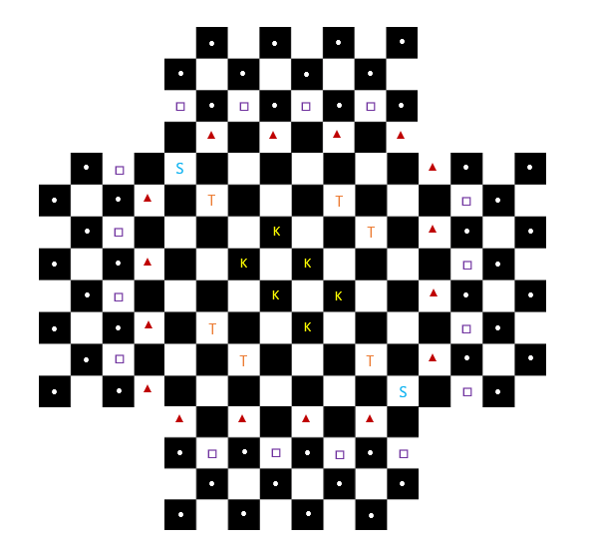
Project Description
Like Checkers
Multi-dimensional
2-4 Players
AI and human opponents
Pawns, Guardsman, Nobles, King
Summon, Tower, and King spaces
Notes:
SCRIPT (LUKE):
Checker Wars is a new, virtual-only take on the game of Checkers.
The game is a multidimensional version of Checkers with extra pieces and new gameplay elements that provide a more challenging experience with greater replayability.
Checker wars will be able to be played by 2 to 4 players against both AI and human opponents at checkerwars.com.
Alex will be walking us through the gameplay in more detail when he goes over the UML and class diagrams, but briefly for context, the game is based on the rules of checkers which means that jumping over another players piece takes that piece, and these jumps can be combined consecutively in one turn when possible.
There are the base pieces called pawns, as well as guardsman, nobles, and kings.
There are also special tile places including the summon, tower, and king tiles which have their own unique abilities.
A game is won when one player is the only player with legal moves on the board, or when 3 towers are captured by a single player.
Alex will be going over the different pieces, tiles, and gameplay scenarios later in the design section of the presentation.

Slide 3
Requirements and Testing
From functional to legal, all requirements are considered and accounted for within the full project description.
Testing utilizes automated unit tests and manual testing for bugs/replayability.
Notes:
SCRIPT (LUKE):
Requirements and testing cover all use cases of the game.
Functional, Data, Performance, Dependability, Maintainability, security, usability, operational, cultural, and legal requirements are all considered and accounted for within the full project description.
Testing is split between automated unit tests and manual testing for bugs/replayability on a multitude of systems.
Because the game will primarily be run through a browser, testing can be streamlined to one platform for the time being.

Slide 4
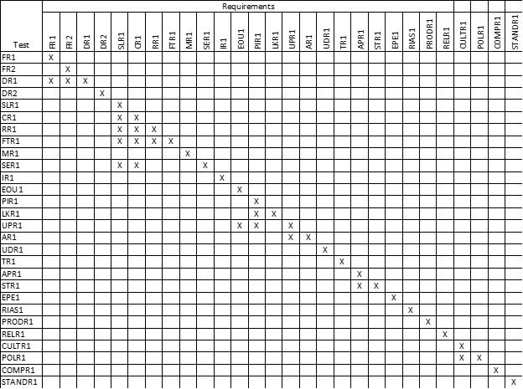
Testing Schedule
Testing and acceptance tests matrix
Data Requirements
Performance Requirements
Precision/Accuracy Requirements
Functional, Dependability, Maintainability, security, usability, operational, cultural, and legal requirements are also accounted for.
Notes:
SCRIPT (LUKE):
As you can see from the testing matrix, the acceptance tests for Checker Wars are thorough.
Accurate recording and display of each player’s data, composed of: the number of games played, won, lost and drawn, ELO (which is the rank of the player), and time played.
Latency must always be minimized to the smallest extent possible in order to facilitate good user experience, but because this is a strategy game, accuracy of both recording and representation of the game pieces are of more importance and testing reflects this.d
Functional, Dependability, Maintainability, security, usability, operational, cultural, and legal requirements are also accounted for in the full project report.
Alex will now take us through the system design and explain how the game works.

Slide 5
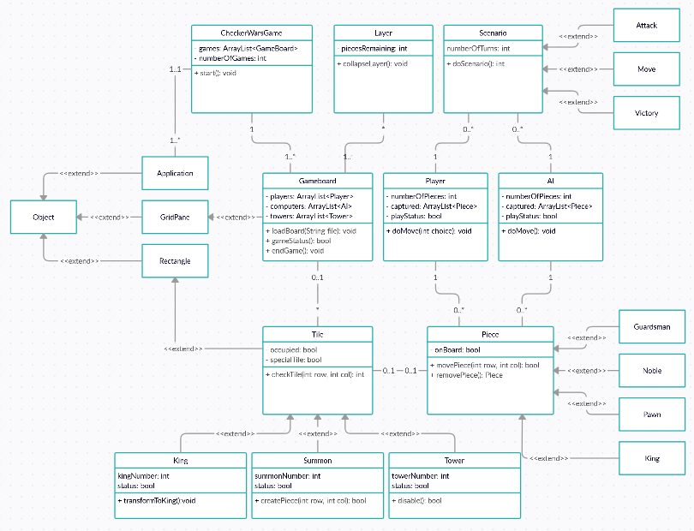
System Design
Speed and latency are important
Accuracy is most important factor
Notes:
SCRIPT (ALEX):
Pictured here is the overall UML diagram showing entire class relationships for the game of Checker Wars.
For most modern video games, speed and latency are the number one concern. However, checker wars is a strategy game, so while speed and latency are important, accuracy of moves is the most important design specification.

Slide 6
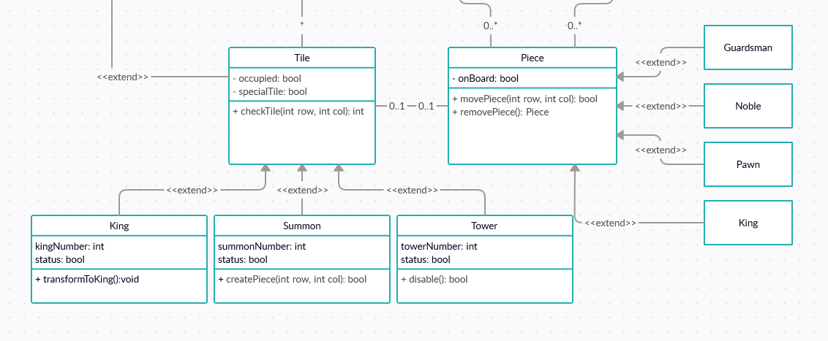
Special Tiles and Game Pieces
Notes:
SCRIPT (ALEX):
This section of the UML diagram demonstrates the relationship between the different tiles and game pieces.
At the top right you can see a class called the piece class. This class will encompass all of the general functions of the pieces including a movement of a piece and the removal of a piece after an attack. We also have a class called the Tile class which will keep track of whether or not the tile is a special tile, whether the space is occupied, and the location of the tile. Using inheritance, we can expand the scope of the Piece class to the guardsman, the nobles, the pawns, and the kings, and the Tile class to the King, Summon, and Tower classes. The guardsman will only be able to attack, the Nobles will only be able to utilize special spaces, the Pawns will only be able to use the king spaces or attack other pieces, and the Kings will be able to attack, move between battlefields, and utilize special spaces. By using inheritance, we can extend all of the functions to their respective piece type. As for the different special tiles, we have the King tile which will take a pawn and transform it into a King using the transformToKing function, there is the Summon tile which will detect whether it is being occupied by a king or a noble piece and summon a pawn to any of its adjacent unoccupied spaces, and finally, the Tower tile which will detect whether it is being occupied by a king or a noble and will be used to keep track of whether or not a team has occupied enough towers to trigger the winning condition. The general blank spaces will just use the tile class since they don’t need the same functionality as the special tiles.

Slide 7
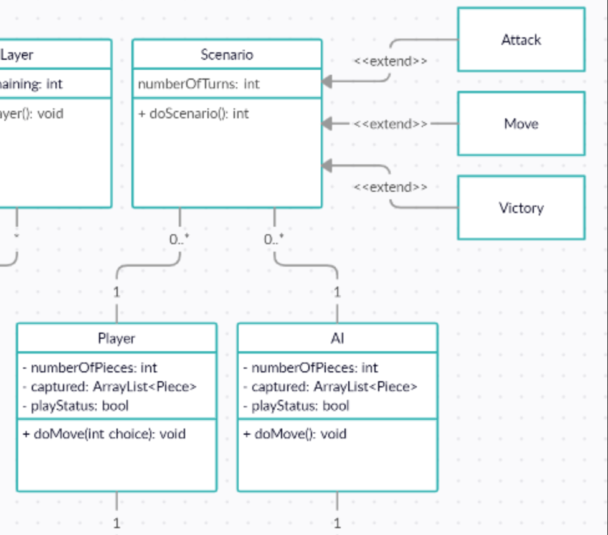
Game Scenarios
Player and AI class keep track of number of pieces, towers captured, and if that player currently has their turn.
Three scenarios include attack, move, and victory.
Notes:
SCRIPT (ALEX):
This section of the UML diagram demonstrates the different moves that are available to the pieces in Checker Wars. Here we have a scenario class, the player class, and the AI class. The player class and the AI class keeps track of certain data such as how many pieces either has, how many towers have been captured by a certain team, and which team has its turn currently. The Scenario class deals with all of the possible actions of the game. Using inheritance, we extend the scope of the Scenario class into the attack class, the move class, and the victory class. These encompass all of the possible game scenarios of the pieces and players. The attack scenario will keep track of either the player’s or AI’s attack or chain attack after the player or AI moves a piece, the Move class will keep track of whether an adjacent space is occupied, and the Victory class keeps track of whether a player or AI has reached a victory condition which includes getting rid of all players’ pieces or capturing a certain amount of towers. Another possible victory scenario that could be used is if the game is timed, then the player with the most pieces or towers captured wins based upon a certain weighting of whether towers or pieces are more important.

Slide 8
Fin
(yemen)
Notes:
Thank you all! Do you have any questions? Heres sam with the national anthem!

